Slide 1
Eyeballin
Submitted By: Bob’s Bullies
Dane Erosa, Isaac Schultz, Rebecca Rothschild, Tim Borisenko, Kenzo Banaag

Slide 2
Mission Statement
We at EyeBallin, are looking to change the game when it comes to indoor navigation and gps for the visually impaired. Our application is voice driven and designed to be a hands free product. Users will be able able to tell their smartphone device a location on one of the four floors at WSU Everett, and our app will generate fast and accurate directions for the user to follow with minimal risk of collision. If the user has an unfortunate fall while navigating through the building, our app will call and text message their immediate emergency contact. Once the user has reached their destination, our device will sound off a chime to end the navigation process.

Slide 3
Our Amazing Logo
E

Slide 4

Features
Our key marketing features:
Accurate and consistent direction delivery.
Voice recognition.
Fall detection.
Multi-level floor processing.
User friendly user interface for the visually and non-visually impaired.

Slide 5
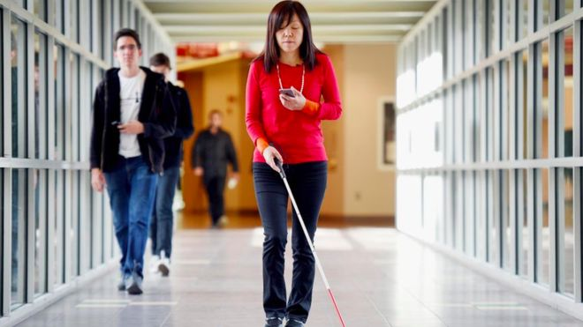
Stakeholders
Visually Impaired
The Development Team
Bolong
Caretakers for the Visually Impaired
WSU Everett Students

Slide 6
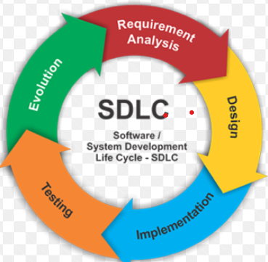
Process Model - Prototyping
Requirement Analysis: Process ended 10/13
Design: Starting 10/14
Implementation: TBD
Testing: TBD
Evolution: TBD
Notes:
Hello I am in need of some memes in the form of an app for the blind. Thank you.

Slide 7
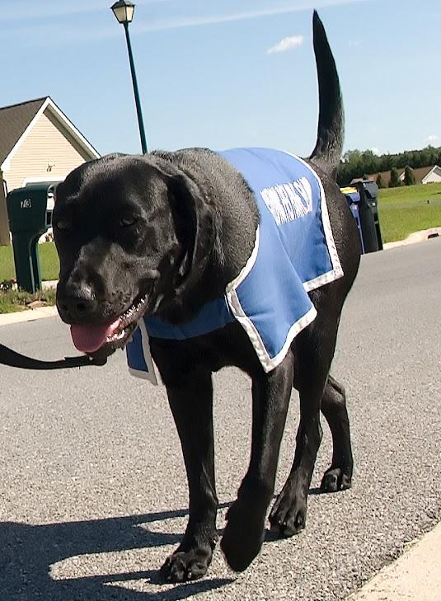
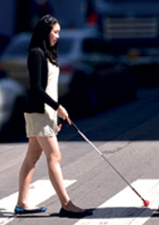

Top Services
Service Dog
White Cane
Path Guide
EyeBallin
E

Slide 8
Function Points : Development Count
1. Inputs: Speech commands, manually entered commands, user emergency contact information.
2. Outputs: Directions, Map, Phone Call, Text Message,
3. Inquiries: Map Data sent to interface
4. Logical files: Map, directions, phone information
5. Interfaces: Destination, Emergency, Directions
How many
1. Inputs: 3
2. Outputs: 4
3. Inquiries: 2
4. Logical files: 3
Internal: 2
External: 1
5. Interfaces: 3

Slide 9
Creeping Rate
Current creep rate:
During the Requirements Specification phase, we added additional functionality for detecting falls, as well as displaying a visual interface to augment the audio interface. A rough estimate would put this at about 10% creep over the month.
Maximum Creep Rate:
We estimate that we would be able to handle about 35% more work over the duration of the project. since we only have about 2 months left to code this project, that would put the maximum creep rate that we can handle at about 15% per month.
Notes:
We have capstone projects, and we have other projects that are more important

Slide 10
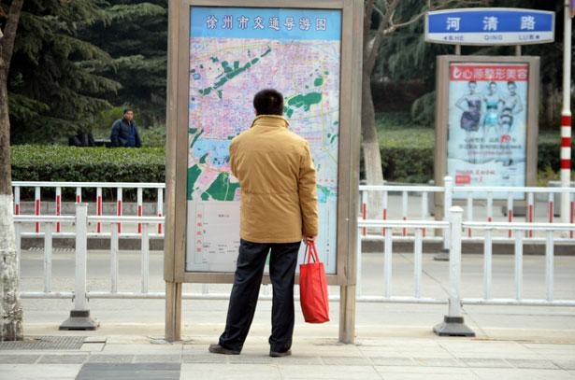
As-Is Scenario-1
Robert Danero was walking to class through the WSU Everett building. He was on his way to the writing center using muscle memory, because he happened to forget his white cane assists him while walking.
He took the elevator and miss-clicked the elevator and ended up on the fourth floor but didn’t know until someone asked where he was going.
Notes:
Some stuff about needing to have a person with you to guide you / a guide dog

Slide 11

To-Be Scenario - 1
While Robert Danero is using the app, he makes the same mistake and ends up on a different floor than where his class was.
EyeBallin, was able to detect and notify Robert that he was on the wrong floor and gave him directions to get back on track.

Slide 12
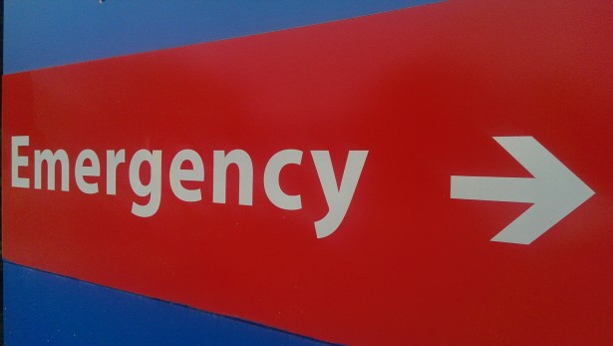
AS-IS Scenario-2
Danezel Washington came out of his study room late in the evening to use the bathroom.
As soon as he walked in, there was a puddle on the ground that he didn’t notice.
He stepped into it, slipped and fell. After about 15 minutes of moaning, security found him and called 911.

Slide 13


TO-BE Scenario-2
As Danezel usually does, he studies late at school. While he was studying late, he got really hungry and decided to go get some food. While leaving his study room, he trips and falls because someone left a chair in the walkway and was knocked unconscious. EyeBallin, immediately called and texted his emergency contact notifying them that he needed assistance.

Slide 14
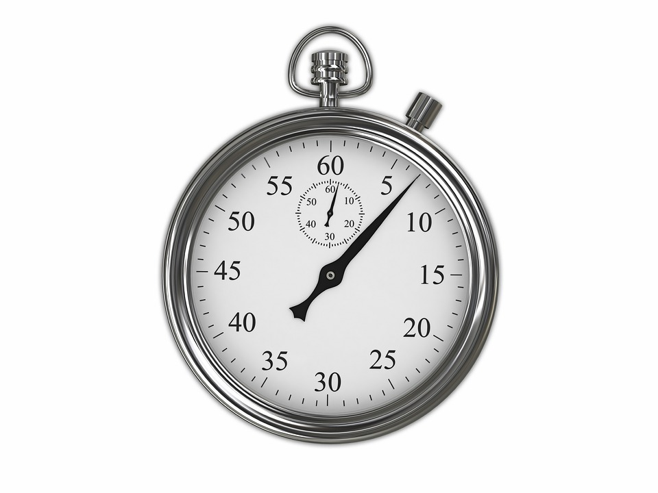
AS-IS Scenario-3
Dane Cook has very short term memory when it comes to directions.
Everyday he walks to class using his white cane but has a hard time finding his classes in a timely manner.

Slide 15
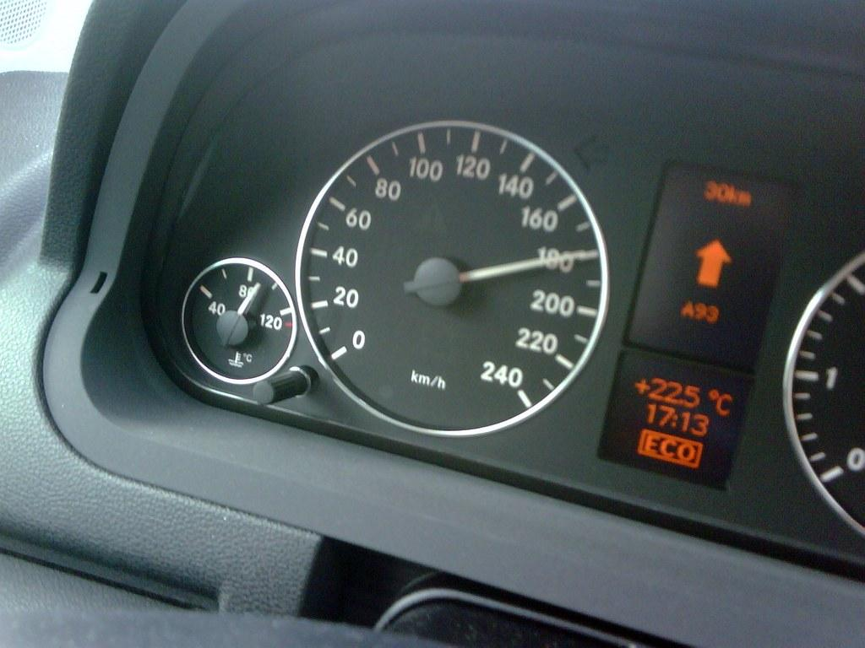
TO-BE Scenario-3
Dane Cook walks into WSU Everett and immediately voice starts the EyeBallin app, tells the app the specific room number and makes it to his first class faster than he ever did before.

Slide 16
Analyzing AS-IS, TO-BE Scenario 3
At what peak level will the navigation know that the floor level has changed?
We’ll measure level changes, as soon as height crosses specific peak, the map in the directory will switch.
How will the user be able to turn off directions manually if they reach their destination and the app continues to run?
Voice commands with “Eyeballin, im here”
or
Voice commands with “Eyeballin, Stop”

Slide 17
Analyzing AS-IS, TO-BE Scenario 3
What could potentially make navigation while using our app make the user at risk?
WSU Wifi or user service goes down.
App not accounting for possible wet floor conditions.
Potential obstacles or hurdles in the path that are unaccounted for.
At what distance will the user be notified if they’re off track on the path?
GPS will detect if user is 5 feet from closest current path marker.

Slide 18
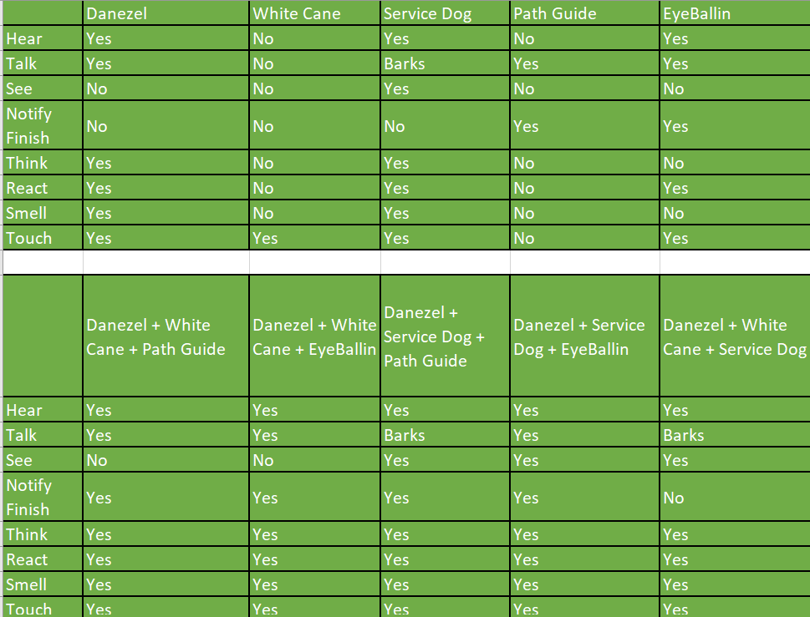
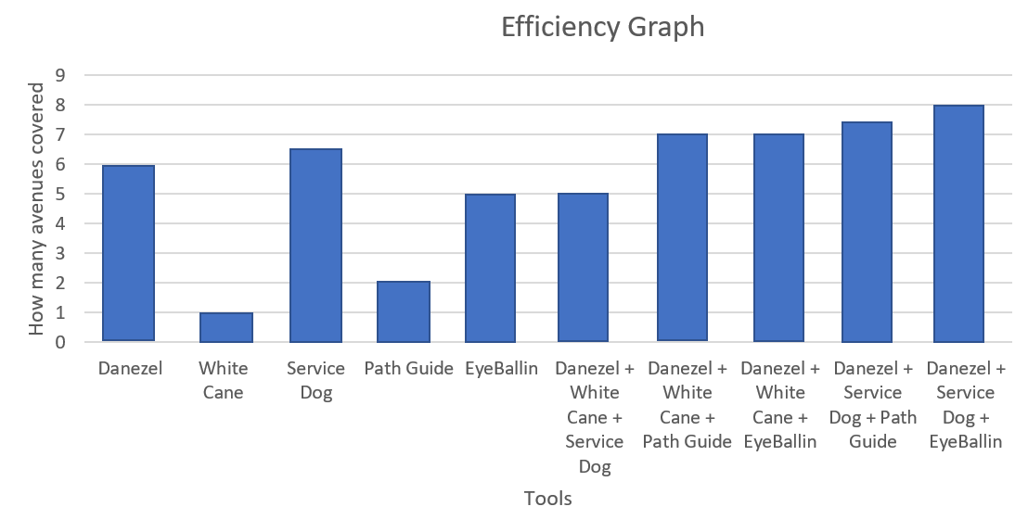
Analytical Comparison

Slide 19
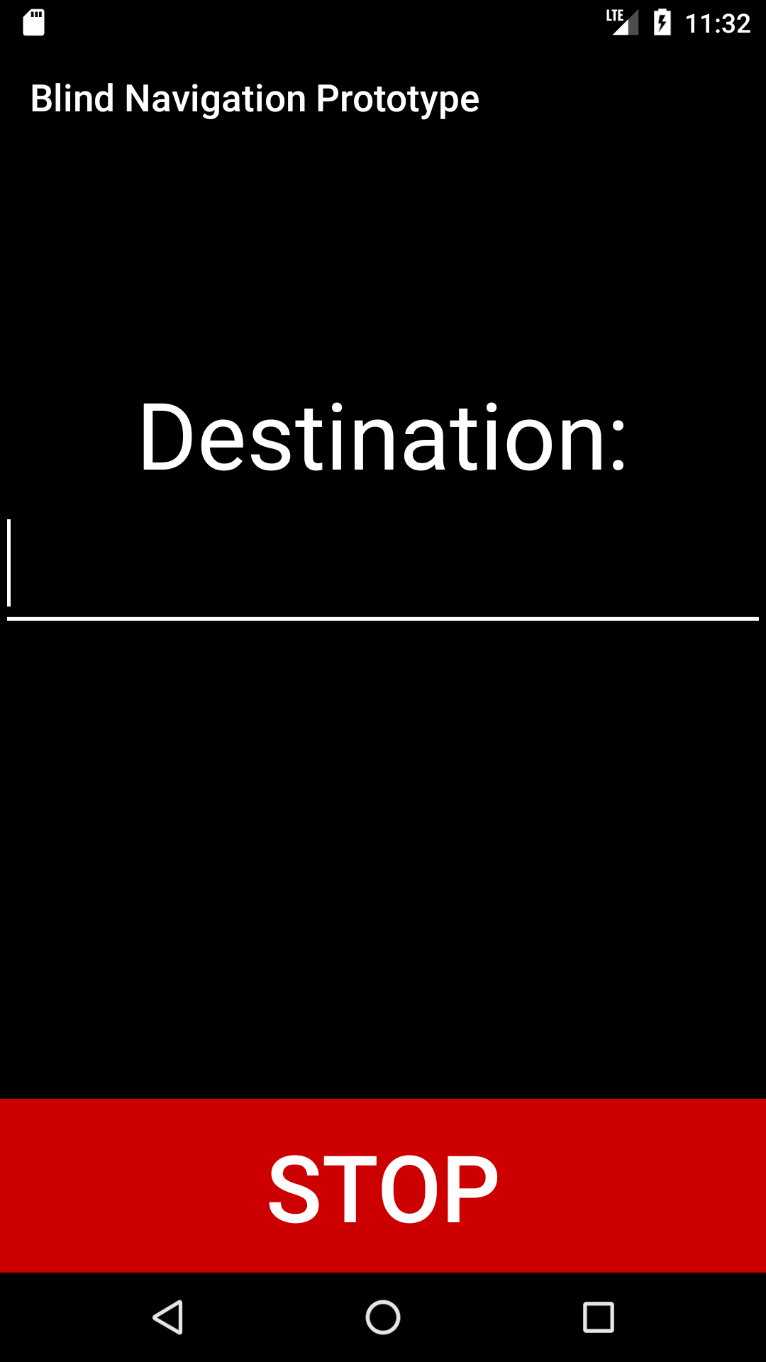
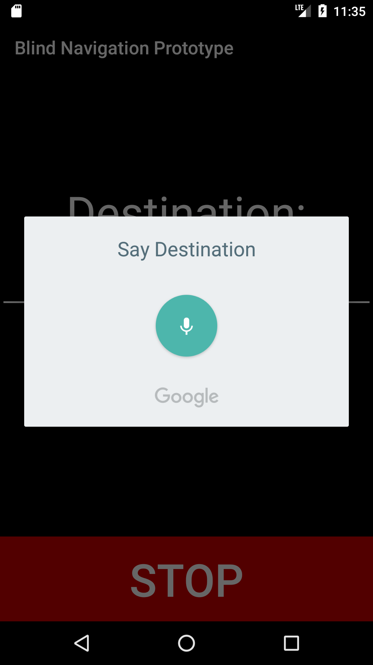
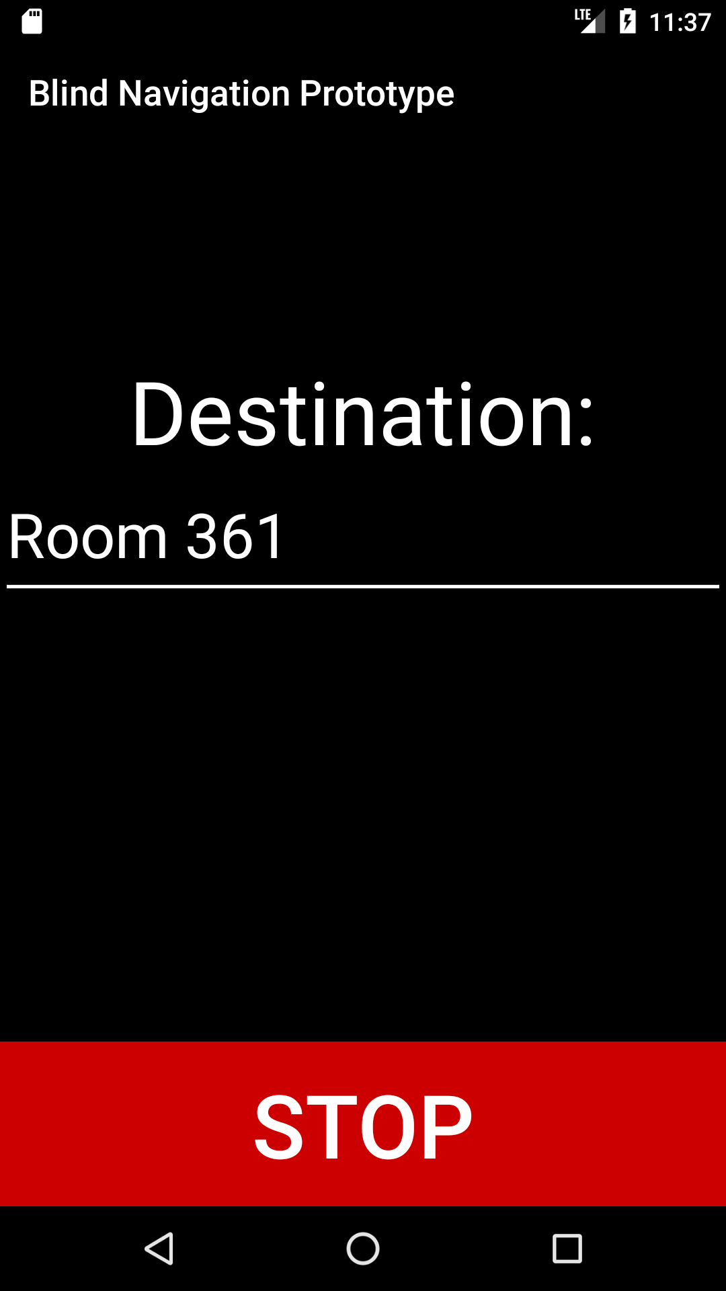
Our Design
App: Hello, please state your destination, or say settings
App: Going to room 361
User: Room 361

Slide 20
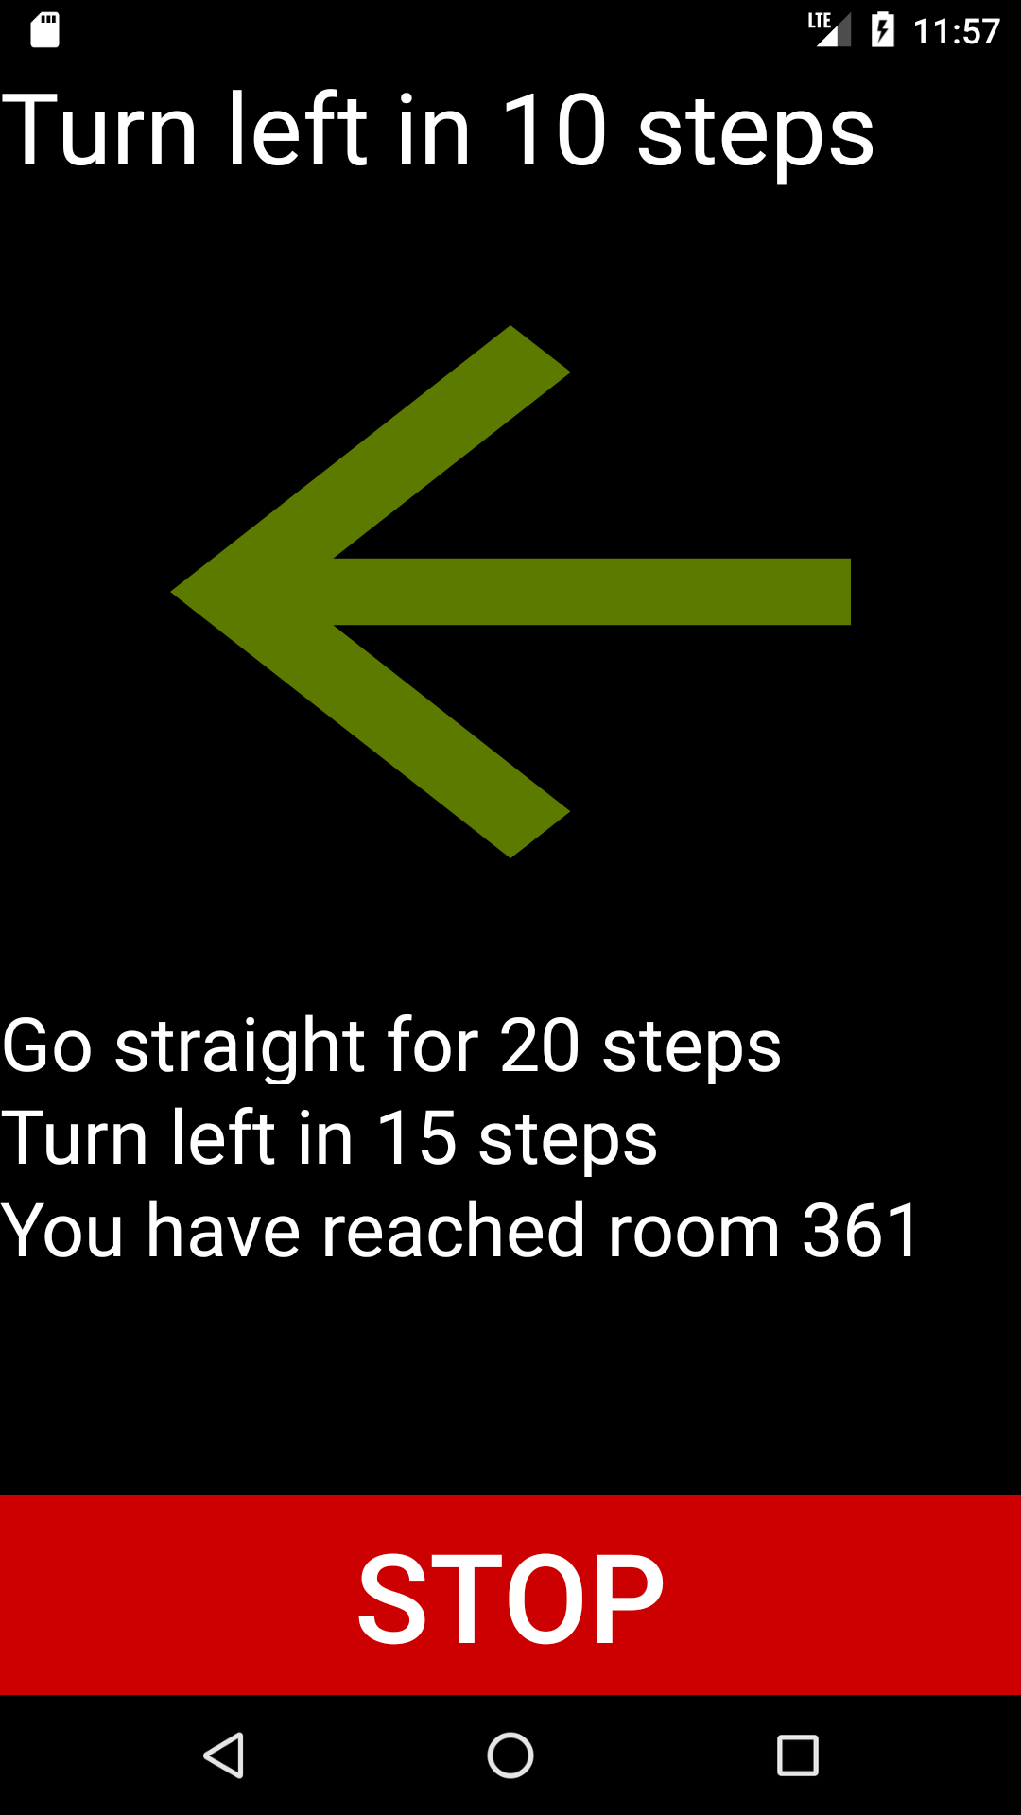
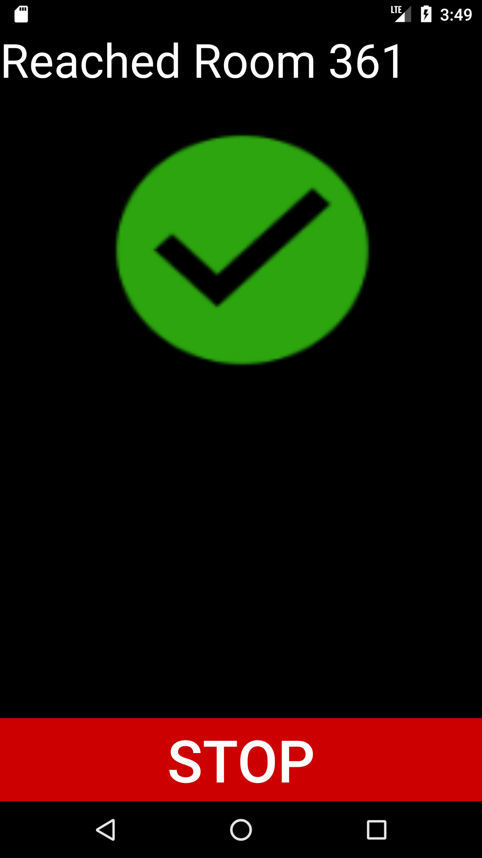
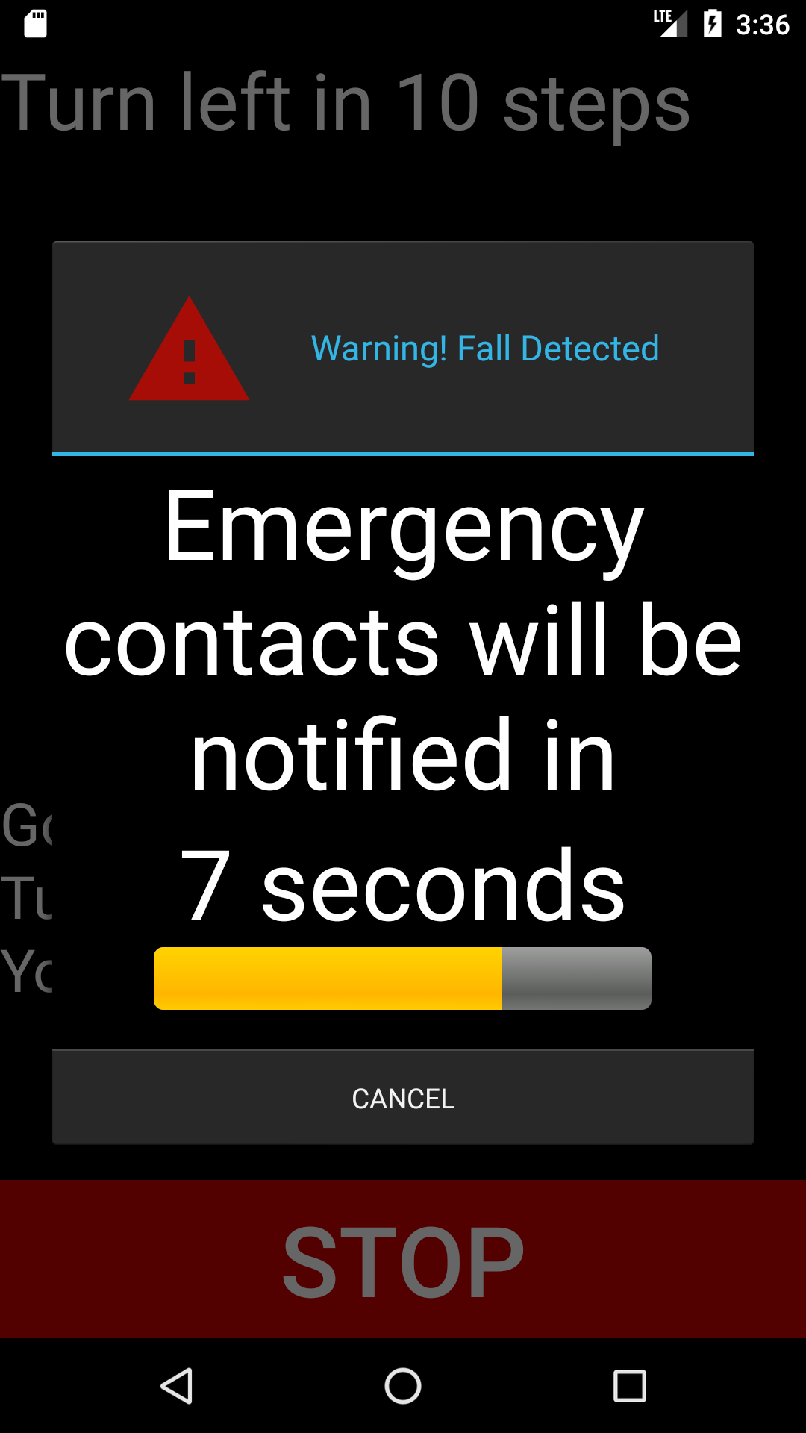
Our Design
App: Fall detected, emergency contacts will be notified in 10 seconds. Say or press cancel to cancel
App: Turn left in 10 steps
App: You have reached your destination

